Slide 1
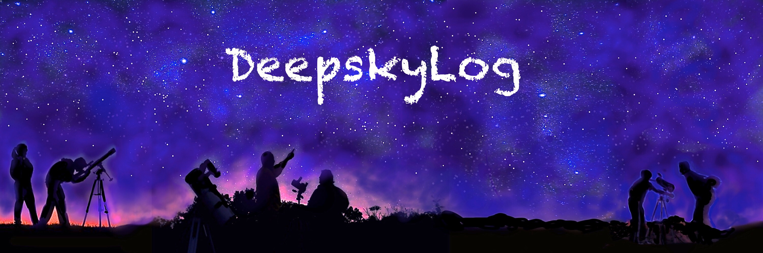
DeepskyLog 5.0
What to expect

Slide 2
New Layout
Bootstrap
Responsive
Easy to use framework
TableSorter
Sorting
Sorting on multiple columns
Movable columns

Slide 3
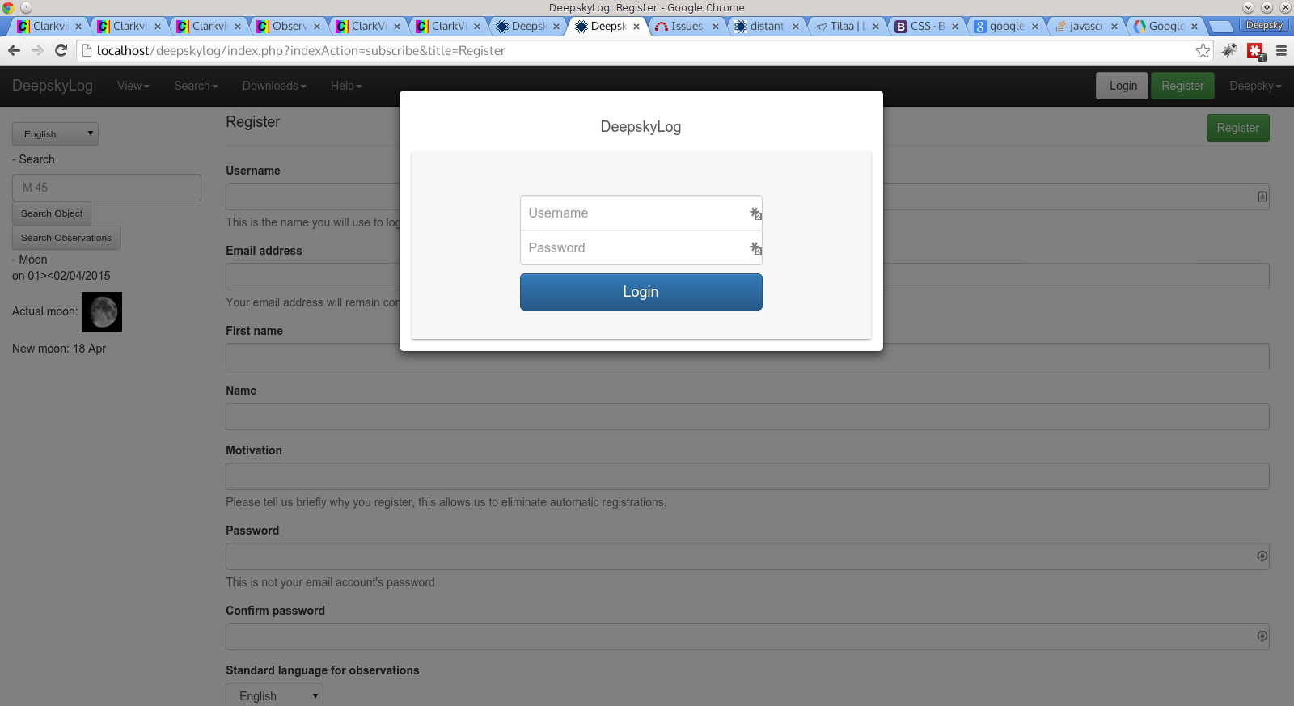

Slide 4
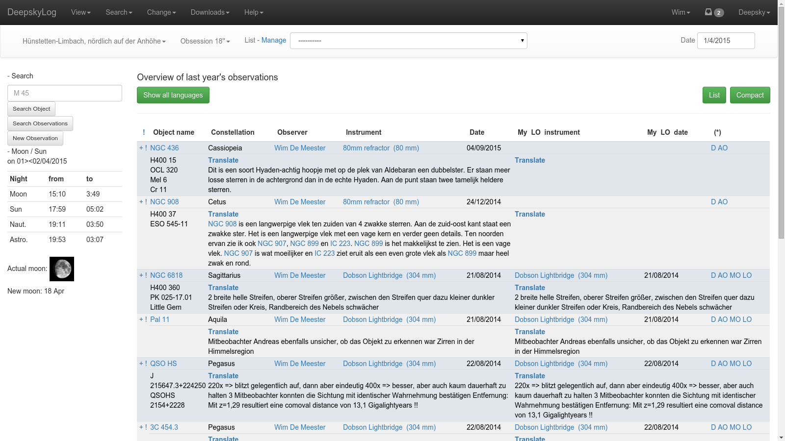

Slide 5
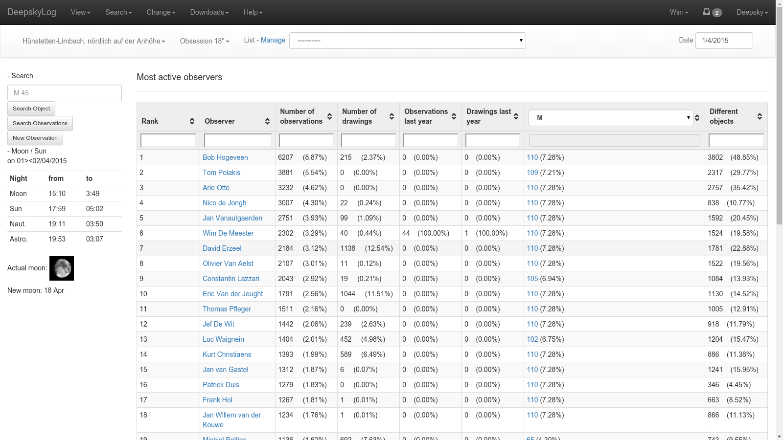

Slide 6
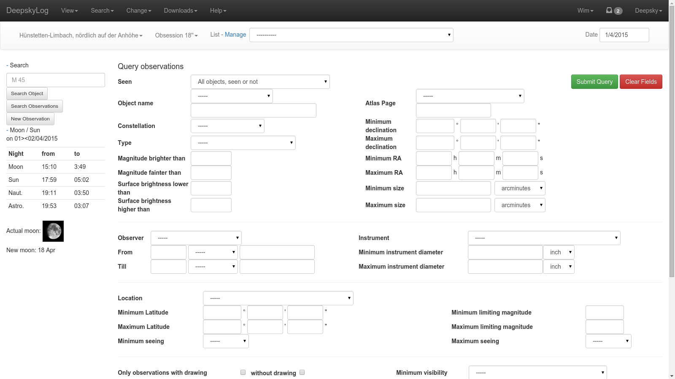

Slide 7
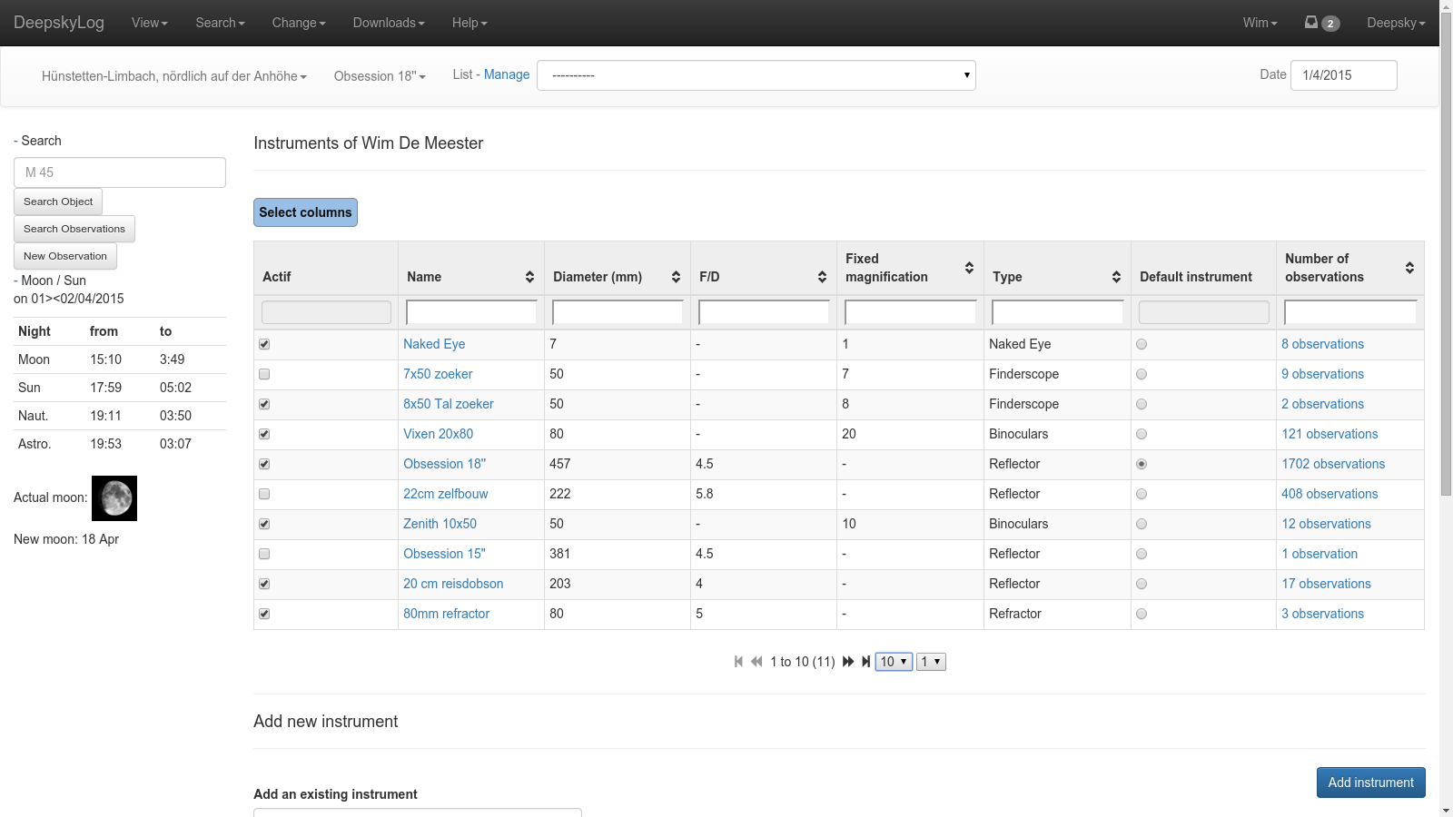

Slide 8
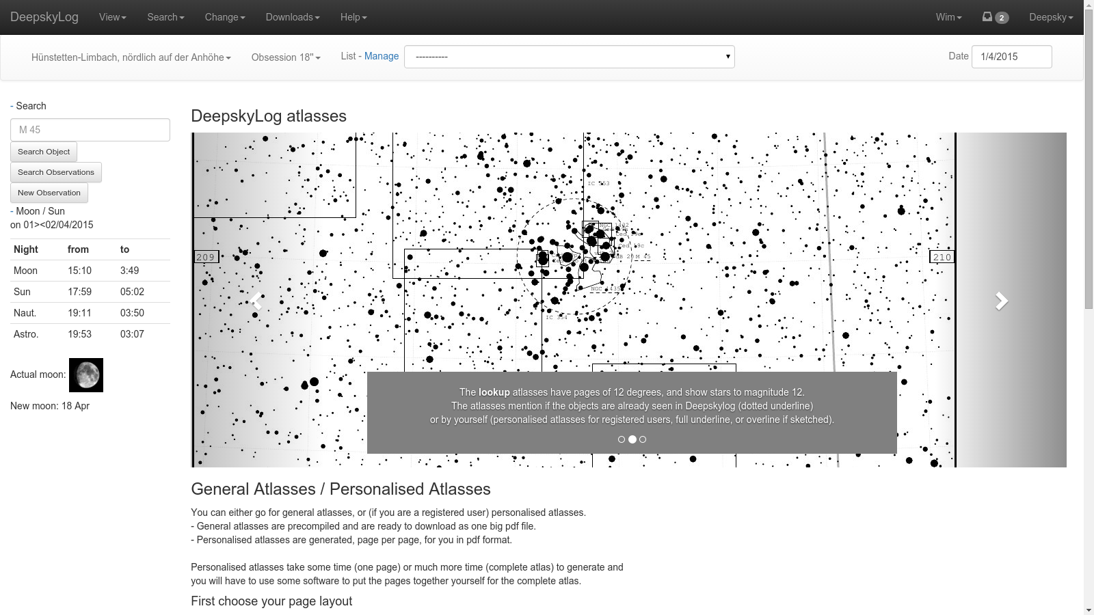

Slide 9
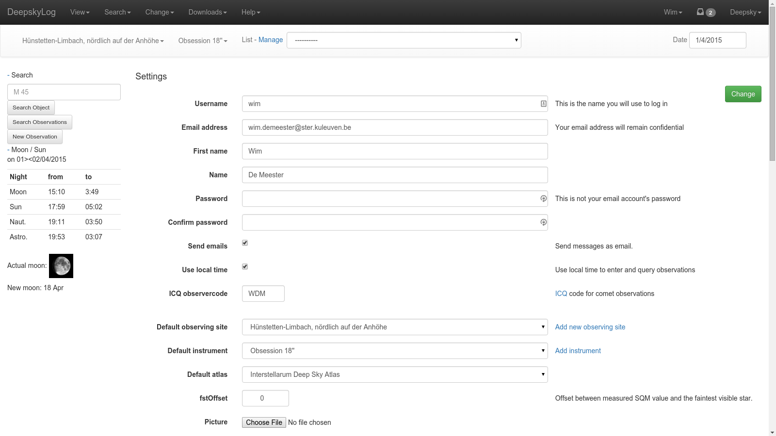

Slide 10
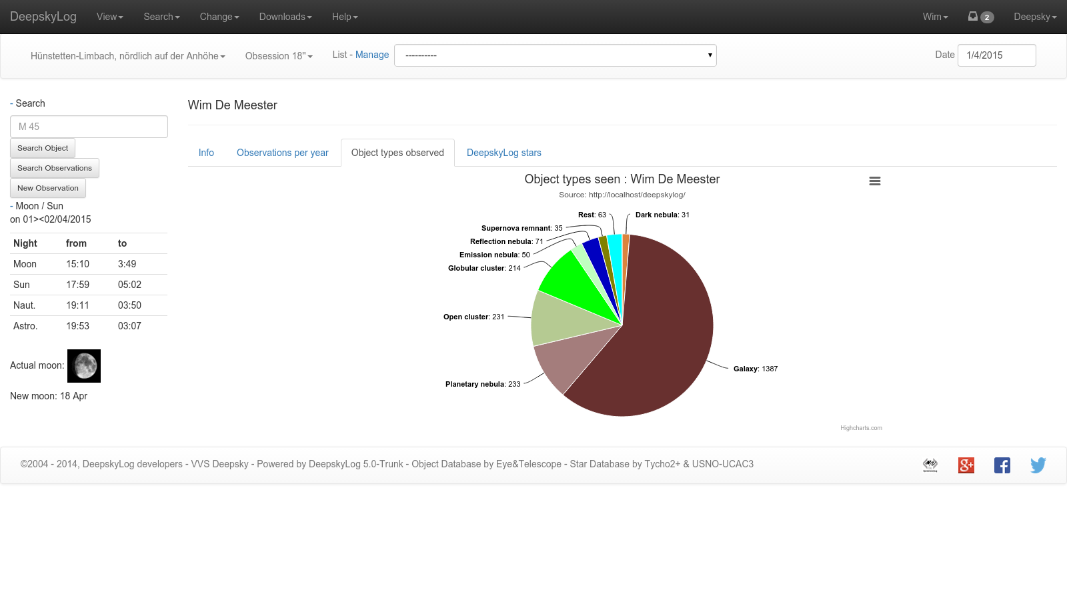

Slide 11
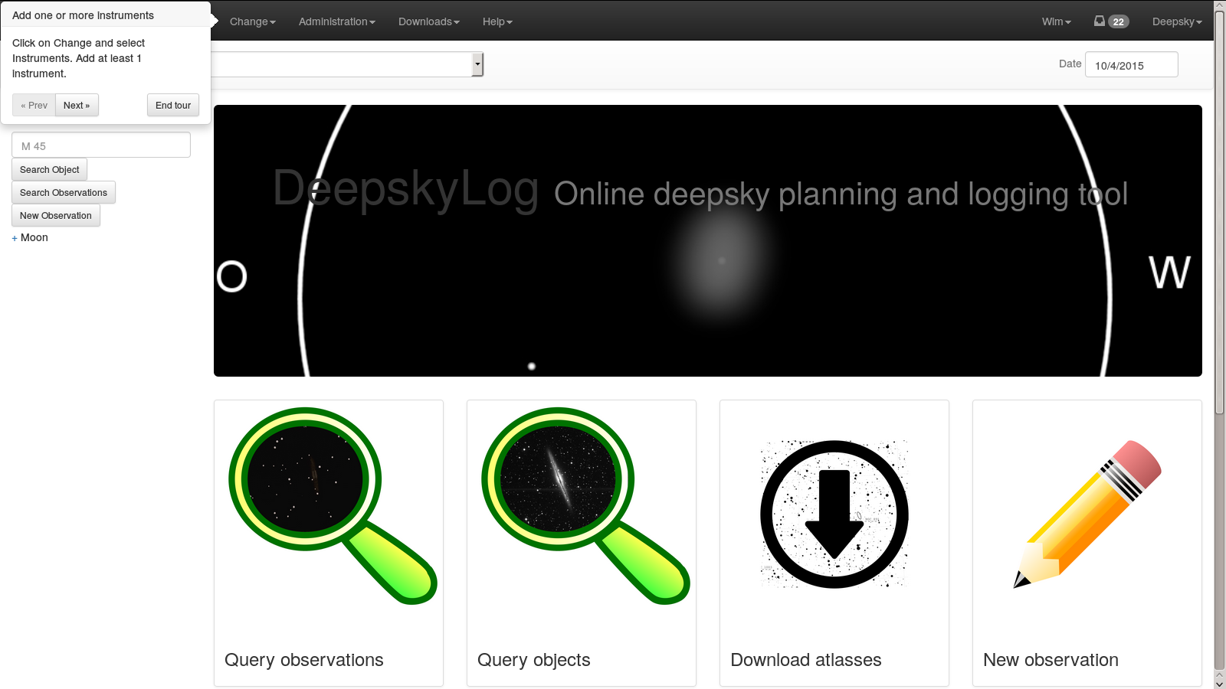

Slide 12
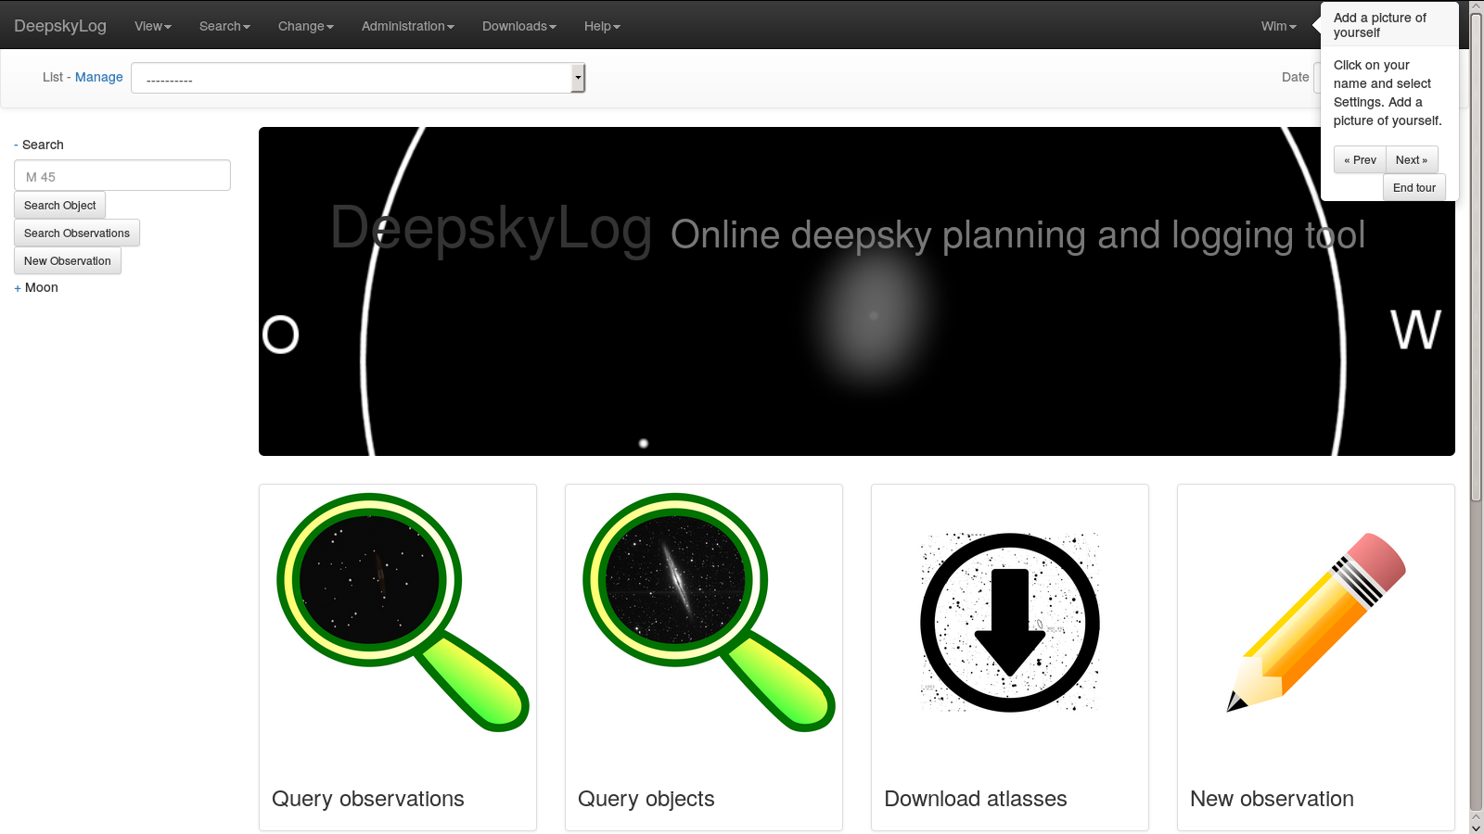

Slide 13
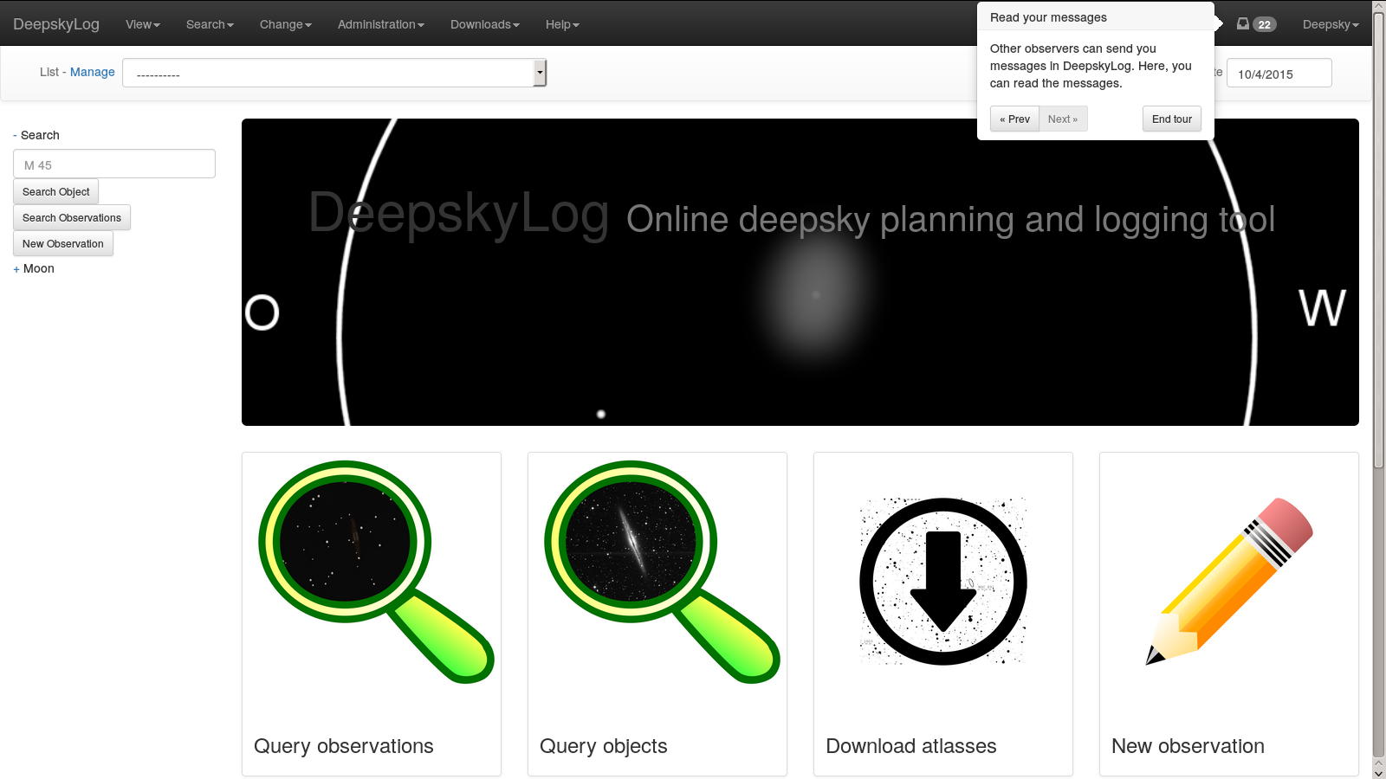

Slide 14
TODO: SCREENSHOT of RESPONSIVE DESIGN

Slide 15
External libraries
jQuery | 1.11.2
jQuery-ui | 1.11.4
Bootstrap | 3.3.2
bootstrap-tour | 0.10.1
tablesorter | 2.18.4
lightbox | 2.7.1
Highcharts | 4.0.4

Slide 16
DeepskyLog Stars
Gamification
Automatic message
Deepsky and comets
Descriptions and drawings

Slide 17
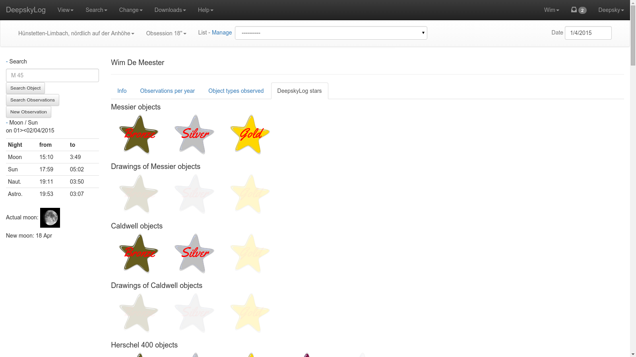

Slide 18
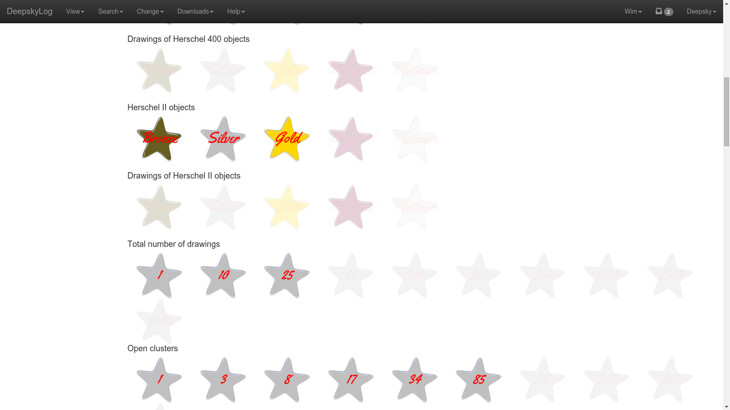

Slide 19
Use real emailaddress
Send message to real email address

Slide 21
Database access
Old mysql methods:
deprecated since php 5.5.
no longer developed since 2006
Migration to PDO_mysql

Slide 22
Picture of observers
In detail of observation.
In messages.

Slide 23
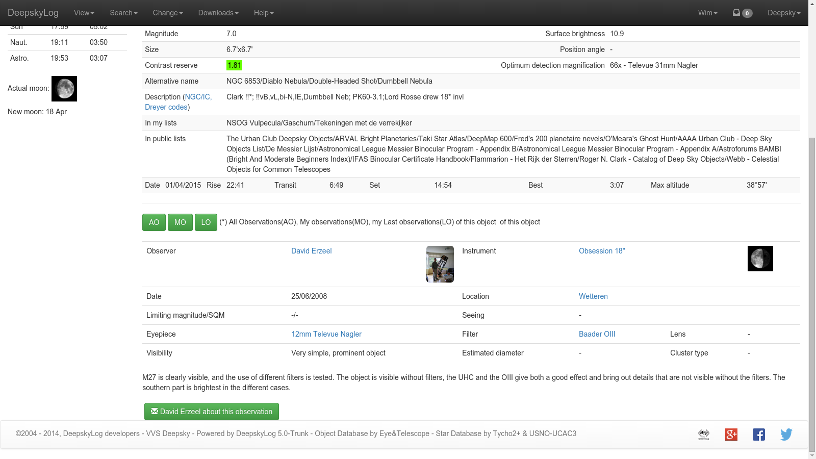

Slide 24
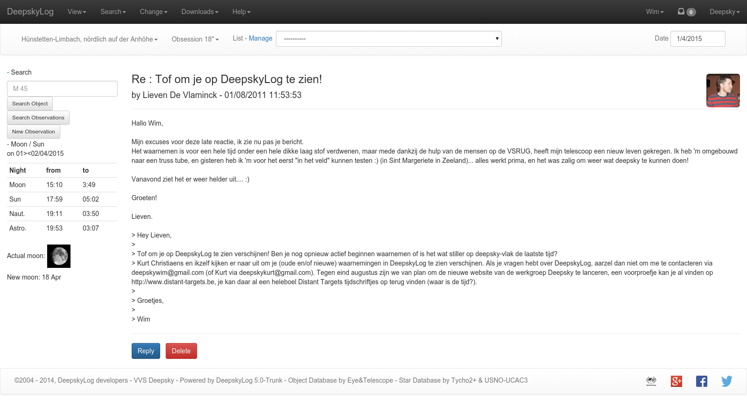

Slide 25
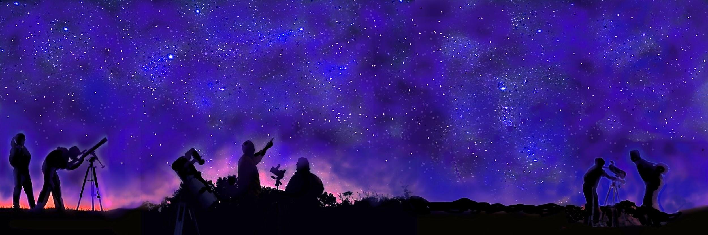
New Logo

Slide 26
New Logo

Slide 27


New Logo

Slide 28
New entry page
Needs new logo

Slide 29
Add locations
Google maps
All your locations are shown on the map.
Update script to
fix wrong locations
fix wrong timezones
add elevation
Don’t show longitude / latitude anymore.
Show weather predictions.

Slide 30
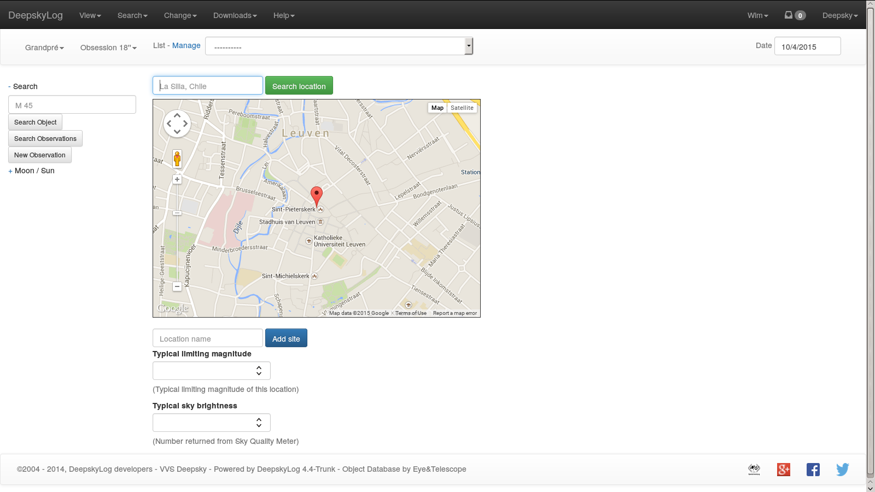

Slide 31
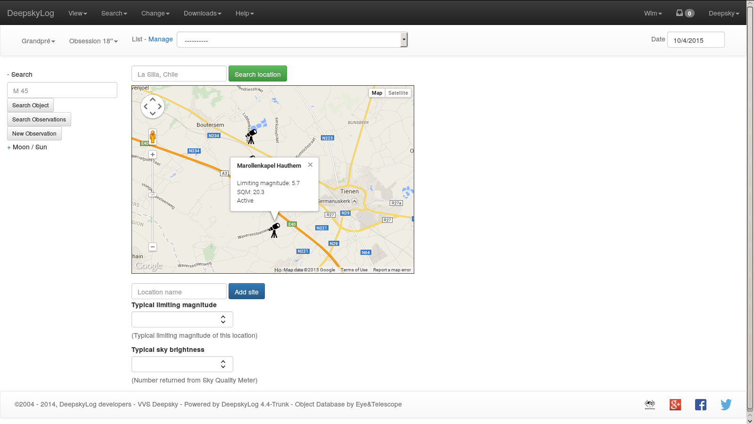

Slide 32
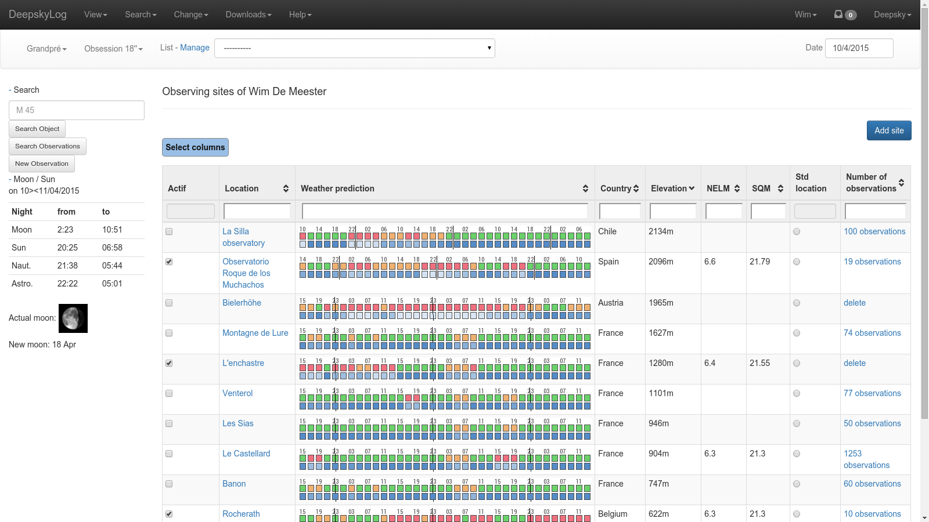

Slide 33
Status deepskylog.se
Person who would help with translation does not respond.
Contact person in Sweden will try to find someone else from the SAAF.
Most persons in Sweden speak English very well.

Slide 34
Questions
Database > 5 gigabyte, mostly in logging table

Slide 35
TODO
Simplify tables
Only show most interesting columns.
Finish new entry page.
Test, test, test!

Slide 36
Input by TC
DeepskyLog is seen by a lot of users as an interface to a database. Should be an easy to use user interface: how?
Downscale start-display of DeepskyLog. Only show relevant information.
Improve quality of data / queries
Filter observations by word count
Shortcuts to frequently used queries

Slide 37
Input by TC
Project to translate DeepskyLog in more languages
Ask current observers to find people to help
Speak to new users / observers
Create short movies for ‘how-to-use DeepskyLog’
Rewrite help section
Survey of users before new release:
What do we want in a new release?

Slide 38
Input by TC
Change Main Menu:
Object data
Observations
My observations
Settings
Help & Startup

Slide 39
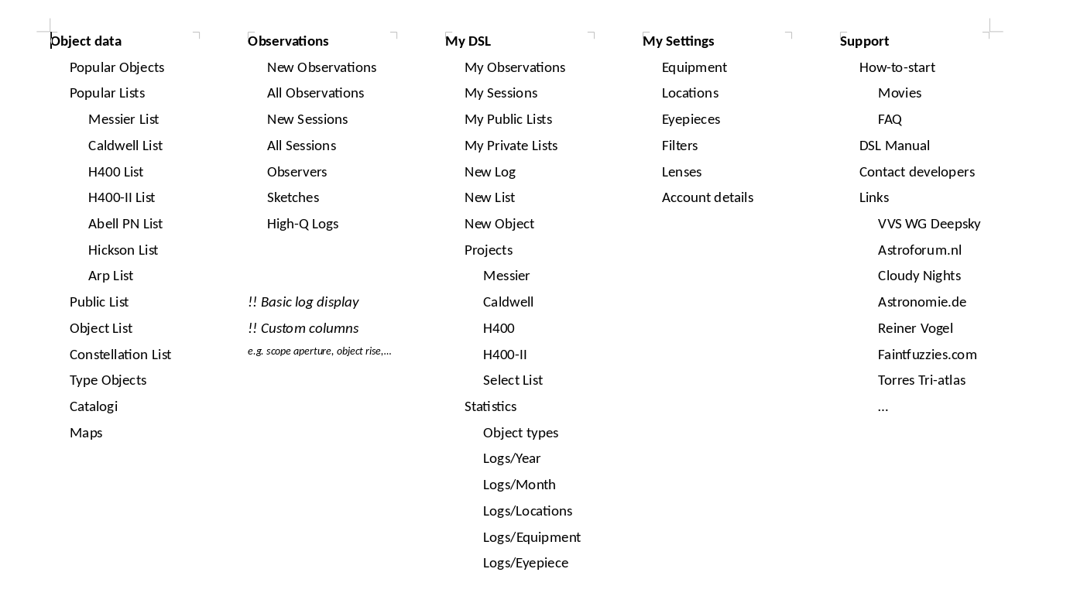

Slide 40
Input by SR
Use black background
List of small corrections / improvements

Slide 41
Input by BT
Let observers grade their own observations:
Class C: Registration of observation
Class B: Good observation, but not perfect
Class A: Top observation, a lot of time and attention went into the observation
Multiple languages for one observations, certainly for Class A observations.

Slide 42
Input by BT
User interface
Tablet friendly: Should be OK in 5.0
Possibility to have shorter column names:
constellations (UMa, ...), type (GX, OC, ...)
Magnification without name of eyepiece.
Different version for beginners and experts.
Better help function.
Tonight’s best function
UNDO button
Add to list should be on the left.

Slide 43
Input by BT
Additional information for objects:
Visibility // Interstellarum Deepsky Atlas
Can we use this data?
Description from reputable observer
More catalogs:
Calabash nebula?
Star catalogs?

Slide 44
Input by BT
Better filters for observations
Using grades: Class A, B, C
SQM / NELM
Location: List is too long…
Instrument: List is too long, no uniform data
Add ‘AND’ to object type
Open clusters AND globular clusters

Slide 45
Input by BT
Observation sheet per object
1 page to find the object
1 page to observe:
Object information
Remarks (by the observer)
DDS image (inverted / not inverted)
Eyepiece / telescope view:
Newtonian
Refractor
SCT

Slide 46
Input by BT
Rework lists
Moderate public lists?
New objects
Add source of new object
Descriptions
Observation should not start with ‘Structure / resolved / …‘

